Slide 1
Center for Teaching, Leading and Learning
November 2, 2018

Slide 3
Strategy 1: Increase the supply of highly effective teachers and leaders and provide supports to ensure they are effective or highly effective.

Slide 4
Strategy 2: Support every principal to be highly effective—especially those leading schools that serve the neediest children.

Slide 5
Strategy 3: Improve targeted supports and professional learning so teachers can deliver excellent instruction today, tomorrow and throughout their careers.

Slide 6
Strategy 4: Identify clear learning standards and guidelines that reflect all four equal learning domains.

Slide 7
Strategy 9: Develop literacy skills across all ages, grades and subjects

Slide 8
Human Capital Online Resource Center
Resources to Attract, Hire and Support Excellent Educators in Ohio
Four Key Areas
Notes:
Coming Soon
Web toolkit

Slide 9
Human Capital Resource Center
Exploring the Education Profession
Educator Recruitment
Mentoring
Professional Conduct
Educator Recognition
Notes:
Web toolkit

Slide 10
Human Capital Resource Center
Development and feedback
Soft launch in October
Hard launch in December
Continual development January and beyond
Notes:
Web toolkit

Slide 11
Strengthening Ohio’s Teacher Pipeline Through Partnership
Departments of Education and Higher Education are offering competitive grants
Up to $25,000 for local districts and educator preparation programs
Sample Text Sample Text
Develop a mutual plan of action for attracting and recruiting teachers
Submission window is closed —applications are being reviewed; notification Nov. 5
Notes:
Ohio Departments of Education and Higher Education - in partnership - are offering competitive grants for up to $25,000 for local districts and educator preparation programs to partner together to develop a mutually accountable plan of action for attracting and recruiting teachers
Submission window is closed
Application review to begin

Slide 12
Diversifying the Education Profession Taskforce
Ohio Departments of Education and Higher Education are convening this taskforce
Center on Great Teachers and Leaders at AIR will facilitate three meetings
Goal is to develop an action plan for implementation
Notes:
ODE and ODHE are convening this taskforce
AIR will facilitate three meetings that focus on Great Teachers & Leaders
Goal is to develop an action plan for implementation

Slide 13
Culturally Responsive Practice Modules
Cultural responsiveness
Sociopolitical awareness
Academic achievement
Notes:
ODE developing with Westat
Ready in late fall
Audience is pre-service and in-service educators

Slide 14
Contact Information for Human Capital Initiatives, Teacher Pipeline, Diversifying the Profession, and Culturally Responsive Practices
Cheryl Krohn, PhD
Center Strategic Administrator Center for Teaching, Leading and Learning
Ohio Department of Education
Cheryl.Krohn@education.ohio.gov

Slide 15
Professional Development
Coming Soon
-Culturally Responsive Practice (CRP) Modules
-Resident Educator Mentors & Mentees Learning Modules
-Ohio Standards for Principals Module

Slide 16
Evaluation
Notes:
We evaluate to inform and support professional development and provide opportunities for structured and informal feedback throughout the performance evaluation process
OTES, OPES, OSCES
Inform and support professional development
Provide opportunities for structured and informal feedback

Slide 17
Evaluation
Summer 2019
Training for pilot
2020-2021
Implementation
Spring 2019
Prototype
2019-2020
Pilot
Evaluation stays the same for
2018-2019 and 2019-2020
Notes:
[When presenting, this slide requires multiple clicks to reveal each element]
We evaluate to inform and support professional development and provide opportunities for structured and informal feedback throughout the performance evaluation process

Slide 18
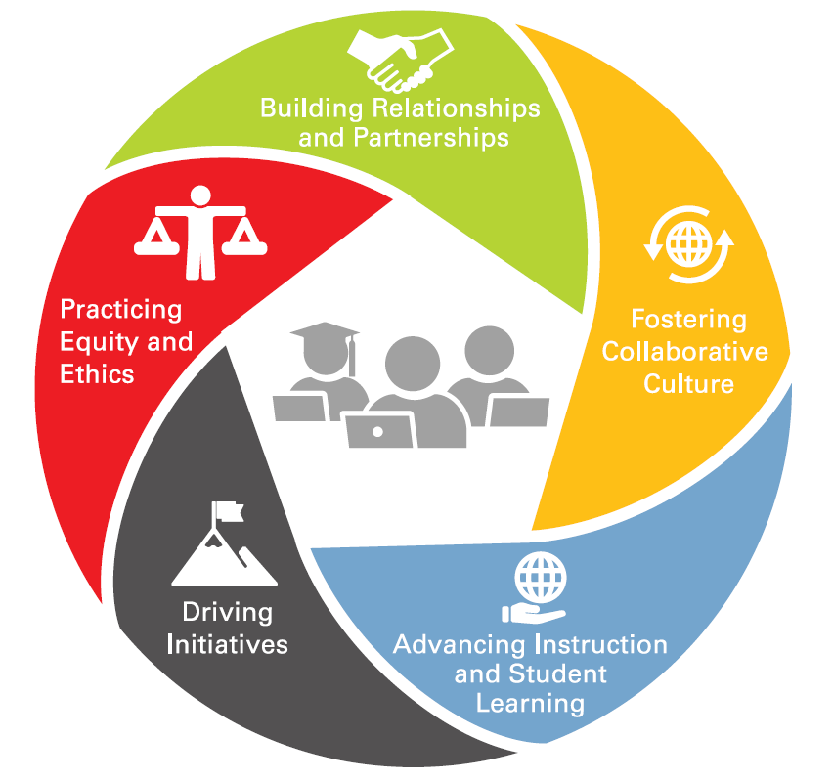
Teacher Leadership Framework
Essential aspects of teacher leadership:
Fostering Collaborative Culture
Advancing Instruction and Student Learning
Driving Initiatives
Practicing Equity and Ethics
Building Relationships and Partnerships
Questions:
teacher.leadership@education.ohio.gov
Notes:
When teacher leadership occurs in schools, positive effects extend to the teacher leaders, to their colleagues, and, most especially, to the students. –Angelle & DeHart, 2016
Teacher leaders hold the expertise to lead and expand the professional learning opportunities and supports available to fellow educators, enabling them to strengthen the profession and enhance student success.
Fostering Collaborative Culture:
Teacher leaders ground their work in mutual trust and clear communication with
colleagues, administrators, students, and families. Teacher leaders use effective interactions among colleagues that engage different back- grounds to respond to challenges and build consensus.
Advancing Instruction and Student Learning:
Teacher leaders advance teachers’ instructional practices and student learning by sharing research on best teaching practices, leading the use of data to inform and guide instructional decisions, and by engaging their colleagues in reflective dialogue.
Driving Initiatives:
Teacher leaders actively identify challenges/areas for improvement and innovation in the school, district, and state/national educational landscape.
Practicing Ethics and Equity:
Teacher leaders foster a positive and inclusive culture that seeks to understand students’ needs and respect the uniqueness of individual students and champion cultural competency and culturally-responsive practice.
Building Relationships and Partnerships:
Teacher leaders create and build strategic relationships and partnerships with colleagues, families, administrators, community members, public officials, higher education, etc. to address immediate and future needs of students, colleagues, school, their profession, and their community.
Teacher Leadership Toolkit:
A toolkit of resources and case studies to further help districts and schools with teacher leadership implementation is being developed for release next spring/early summer.

Slide 19
Teacher Leadership Work
Teacher-In-Residence
Teacher Leader Advisory Council
Future Teacher Leadership Summit
Resource Development
Teacher Leadership Survey

Slide 20
Troops to Teachers
Seeking partner districts and IHEs
Recruit and onboard former military service members into the teaching profession
Contact David.Schklar@education.ohio.gov
Notes:
Interested schools (including community schools) that would like to partner with ODE in recruiting and on-boarding former military service members into the teaching profession should contact John.Solonika@education.ohio.gov

Slide 21
Teacher Recognition and Awards
Presidential Awards for Excellence in Mathematics and Science Teaching Deadline: Spring 2019
Ohio Teacher of the Year
Deadline: Spring 2019
State Talent Pool of Excellent Teachers
Deadline: Spring 2019
1
2
3
Notes:
What does the applications bullet mean…We (ODE) don’t solicit applications. Assoc’s support this by soliciting in their communications to the field?
There are 11 state board districts.
How can we find the territory leads for each district? A map on the ODE – OTOY website/contact info or call/email Angela Dicke. Territory leads’ names and contact information are on the OTOY nominations form.
Are all awards/recognition open to Community Schools? Yes. We (ODE) solicit districts and schools through EdConnections to make nominations for PAEMST and OTOY. Milken is not solicited by ODE but we use our Talent Pool to solicit “recommendations”.

Slide 22
Teacher Recognition and Awards
Nominations are solicited from districts, schools and professional associations — not the Ohio Department of Education
Visit: education.ohio.gov
Search: Rewards and Recognition
2020

Slide 23
EdRising Ohio
Student organization recruits middle and high school students interested in education-related careers
1,000+ student members across the state
Districts and Community schools may sponsor local chapters
IHEs partner with local chapters and events
Notes:
Which community schools already have chapters?
None that we are aware of.
Where do I go to find out how to set up a chapter?
Contact coordinators, Angela – We are developing a “How to” packet to post on our webpage
What are the benefits of having a chapter?
The Educators Rising Ohio Mission
Educators Rising Ohio provides the foundation upon which Ohio students can develop the skills and knowledge necessary to pursue careers in education.
What Educators Rising Ohio Chapters Do
For students . . . Educators Rising Ohio helps them to explore teaching as a career option, provides them with a realistic understanding of teaching, and encourages students from diverse backgrounds to think seriously about the teaching profession.
For teachers . . . Educators Rising Ohio offers them a chance to shape our nation's future by shaping the future of the education profession. It also gives teachers opportunities to examine, clarify, and explain their role in students' lives.
For schools . . . Educators Rising Ohio is a service opportunity that elevates the role of teachers and offers new avenues of communication about education and its place in the community.
For communities . . . Educators Rising Ohio provides a chance for communities to "grow their own" future teachers and raises the status of the education profession in the eyes of their citizens.
For colleges . . . Educators Rising Ohio expands the pool of applicants to teacher education programs and provides early identification of potentially excellent future teachers.
For the education profession . . . Educators Rising Ohio extends the vision of the profession by enlarging the talent pool. It creates a positive image of teaching for students, parents, and other citizens, and it encourages the influx of new ideas and diverse points of view.

Slide 24
Visit: education.ohio.gov
Keyword Search: ABConduct
Notes:
Proactive Tip Sheets
Social Media & Extra Curriculars
http://education.ohio.gov/Topics/Teaching/Educator-Conduct/ABConduct
Review of Licensure Code of Professional Conduct
Professional Conduct Process Chart

Slide 25
Regional Support Specialists
Assessment Design/Revision
Depth of Knowledge
Standards Alignment
Problem-Based Learning
Growth Mindset
Teacher Leadership
OTES Administration Calibration
SLO Committee Calibration
OTES Connections for Teachers

Slide 26
Regional Support Specialists
Apryl.Ealy@escneo.org
NW, SW, Central
Cathryn.Shaw@escco.org
SW, SE, Central
Thomas.Rounds@escneo.org
NE and Central
Erik.Sikora@escneo.org
NE

Slide 27
Educator Licensure
Career-Technical Licensure
P-5 Licensure
Substitute Teaching Licensure

Slide 28
House Bill 98
Revised Career-Technical
Workforce Development Licensure
-Initial 2-year CT license
Employed in a CTE position
Has 5-years of work experience in the subject area
Enrolled in a CTE preparation program
-Advance to a 5-year CT license
Successfully completed a preparation program
Passed a summative performance-based assessment

Slide 29
Senate Bill 216
-Licensure Grade Bands
New PK through 5, replaces PK through 3
No change for current license holders
-Substitute Teaching Licenses
Replaces current short-term and long-term substitute license structure
New licenses allow teaching an unlimited number of days with a post-secondary degree in education or in “a subject area directly related to the subject of the class”
New licenses must be implemented by July 1, 2019

Slide 30
Department Contacts
Carolyn.Everidge-Frey@education.ohio.gov
Center for Teaching, Leading and Learning
John.Soloninka@education.ohio.gov
Office of Educator Effectiveness
Jill.Grubb@education.ohio.gov
Office of Educator Effectiveness
Sophia.Hubbell@education.ohio.gov
Office of Educator Licensure

Slide 31
education.ohio.gov

Slide 32
Join the Conversation
OHEducation
@OHEducation
@OHEducationSupt
OHEducation
OhioEdDept
education.ohio.gov/text

